Slide 1
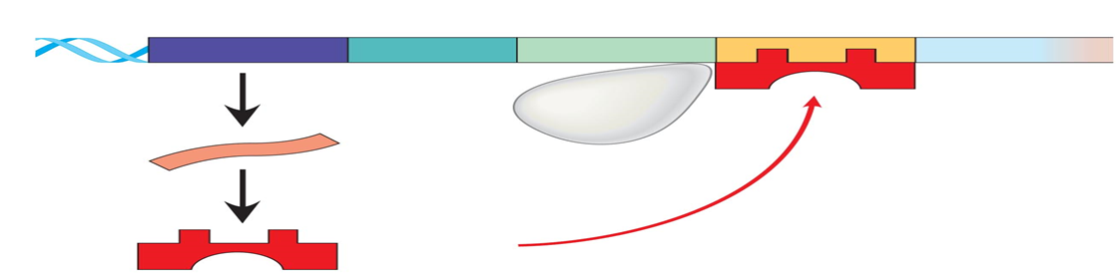

REGULATION OF GENE EXPRESSION
Lecture 1-2 continue…..
Dr. Dina Ahmed Hassan Ibrahim

Slide 2
When glucose is absent & lactose is present:
Positive regulation: The lac operon is induced.
To activate Lac operon and allow for the transcription of the Z, Y & A genes, the following two conditions must be fulfilled:
- The operator (O) site must be free (not bound to the
repressor protein).
- The catabolite activator protein (CAP) is bound to cAMP to
form the cAMP–CAP
trans-acting complex.
As a result, RNA polymerase will efficiently initiate transcription at the promoter site.

Slide 3
1/ How to keep the O site empty:
Small amount of lactose is converted to an isomer, allolactose. Allolactose is an inducer that binds to the repressor protein preventing its binding to the operator.

Slide 4
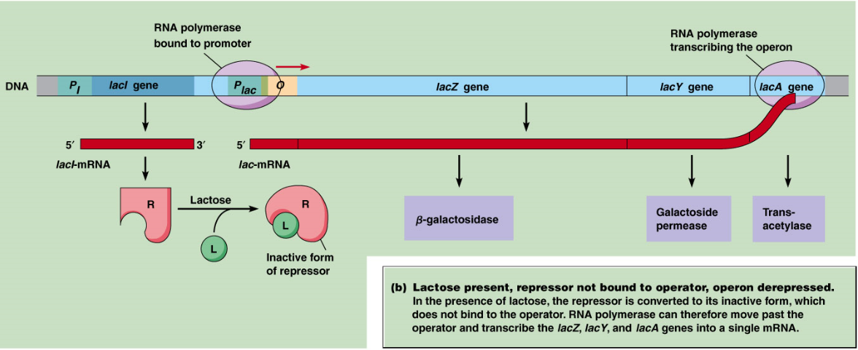
Presence of lactose and absence of glucose:

Slide 5
2/ Formation of the cAMP–CAP trans-acting complex:
In the absence of glucose, adenylyl cyclase is active, and sufficient quantities of cAMP are made and bind to the CAP protein.

Slide 6
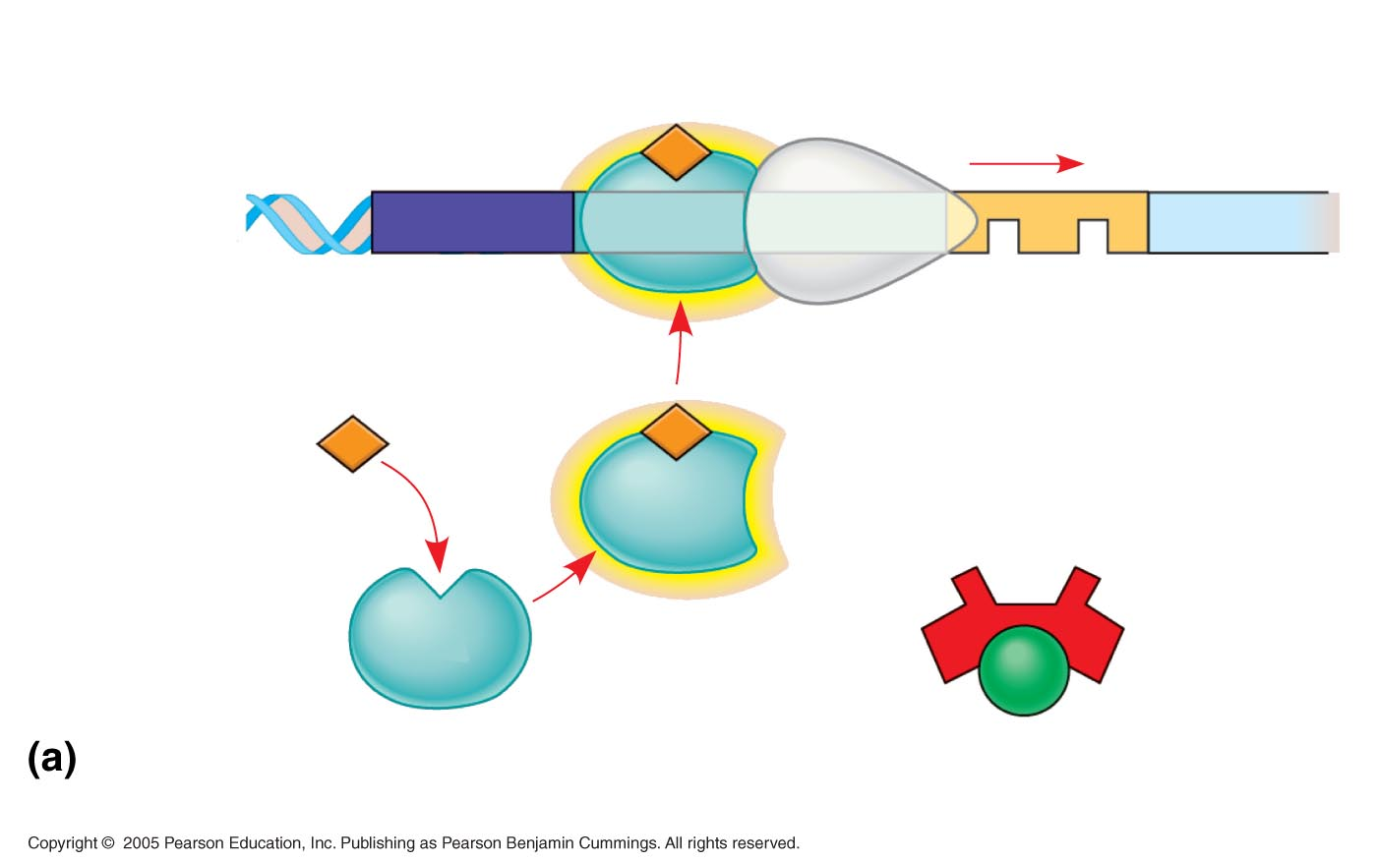
LE 18-23a
Promoter
DNA
lacl
lacZ
CAP-binding site
RNA
polymerase
can bind
and transcribe
Operator
Active
CAP
cAMP
Inactive lac
repressor
Inactive
CAP
©
Lactose present, glucose scarce (cAMP level high): abundant lac
mRNA synthesized

Slide 7
The transcript is a single polycistronic mRNA molecule that contains three sets of start and stop codons.
Translation of the mRNA produces the three proteins that allow lactose to be used for energy production by the cell.

Slide 8
When both glucose and lactose are available:
Transcription of the lac operon is negligible even if lactose is present at a high concentration.
Adenylyl cyclase is inhibited in the presence of glucose (a process known as catabolite repression) so no cAMP–CAP complex forms, and the CAP site remains empty.

Slide 9
RNA polymerase is unable to effectively initiate transcription, even though the repressor may not be bound to the operator region.
Consequently, the three structural genes of the operon are not expressed effectively(very small amounts of the enzymes are produced).

Slide 10
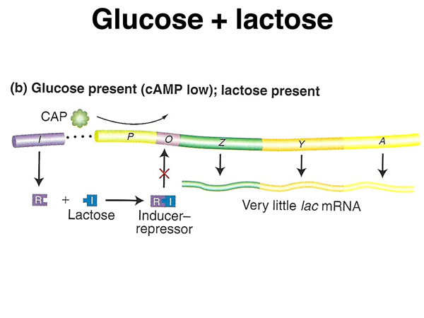

Slide 11
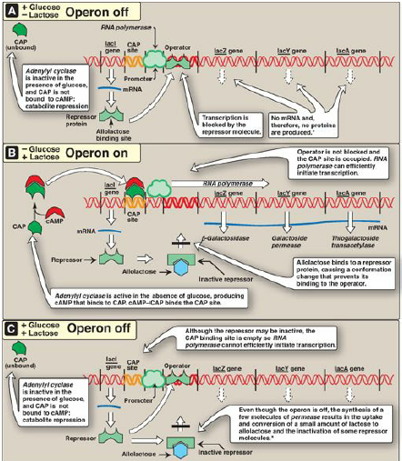

Slide 12
REGULATION OF GENE EXPRESSION IN EUKARYOTES
DNA level (replicational)
Transcriptional
Post- transcriptional
Translational
Post- translational

Slide 13
A- GENE REGULATION AT DNA LEVEL
Gene amplification: generating many copies of genes to produce large numbers of specific proteins
Gene rearrangement: movement of segment of DNA into another location in the genome, associating with other segments to produce another proteins

Slide 14
Gene rearrangement
V1
V2
V3
V4
V5
D1
D2
D3
D4
D5
J1
J2
J3
J4
J5
Constant region
Recombination
Constant region

Slide 15
Gene loss: e.g mature erythrocytes (immature erythroblasts contain nuclei→ mRNA → globin chains for haemoglobin
- mature RBCs don’t contain nuclei and hence no genes (no mRNA)

Slide 16
Methylation of DNA: inactivation of DNA of some cells during differentiation and repeated cell division

Slide 17
B-TRANSCRIPTIONAL REGULATION
Chromosomal Packaging: regulating large area of chromosomes
- Formation of heterochromatin:
transcriptionally inactive form of chromosome (Barr body) e.g: inactivation of one X-chromosome in females.
(Barr body: highly methylated chromosomes)
- Formation of euchromatin:
transcriptionally active form of chromosome

Slide 18
B-TRANSCRIPTIONAL REGULATION
Individual gene regulation:
Similar to the regulation of operons in prokaryotes.
Regulatory factors:
To initiate transcription, we require:
- promoters
- transcriptional factors: binds to promoters and enhancers

Slide 19
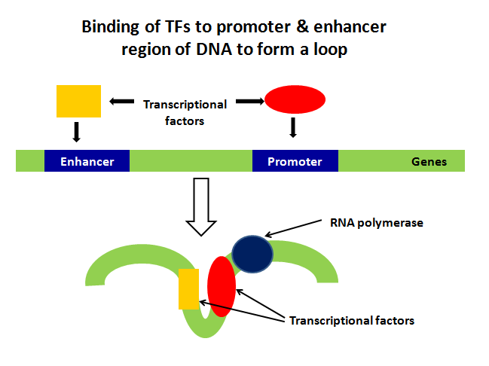

Slide 20
C-POST TRANSCRIPTIONAL REGULATION
Occurs after the RNA is produced
More extensive in eukaryotes than prokaryotes
It includes:
Alternative splicing
RNA interference (RNAi)
Regulation of RNA stability

Slide 21
C-POST TRANSCRIPTIONAL REGULATION
Alternative splicing:
Alternative splicing is a cellular process in which exons from the same gene are joined in different combinations, leading to different, but related, mRNA transcripts. These mRNAs can be translated to produce different proteins with distinct structures and functions — all from a single gene.

Slide 22
Example 1:
Transcripts of the rat calcitonin/calcitonin gene-related peptide (CGRP) gene are alternatively spliced in a tissue-specific manner resulting in the production of calcitonin mRNA and peptide in thyroid C cells and CGRP mRNA and peptide in neurons.
Thyroid gland -> calcitonin hormone (calcium regulation)
Neurons-> calcitonin gene-related peptide (taste)

Slide 23
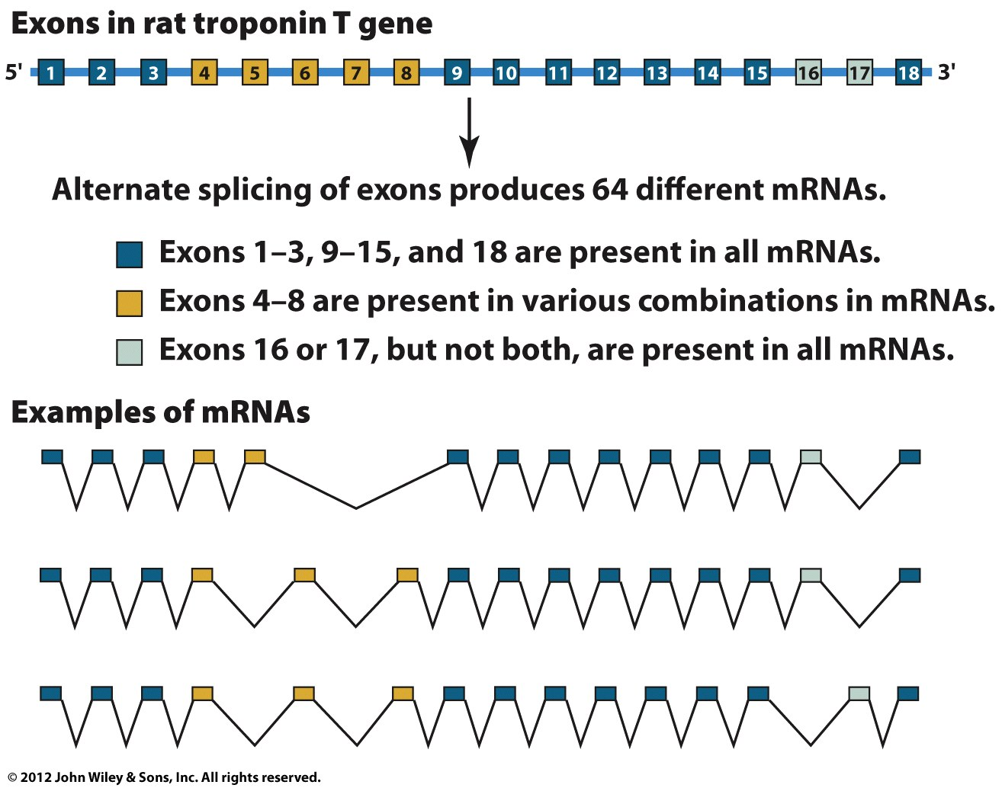
Example 2:
Alternate splicing of the rat troponin T gene

Slide 24
C-POST TRANSCRIPTIONAL REGULATION
RNA interference (RNAi):
Small, non coding RNAs which interfere with the expression of target mRNA by binding to a specific sequence in the mRNA

Slide 25
C-POST TRANSCRIPTIONAL REGULATION
Regulation of RNA stability:
- Nucleus: formation of heterogeneous nuclear RNA (hnRNA) -> degradation before transport to the cytoplasm
- Cytoplasm: availability of mRNA is regulated by RNA stability (duration of action=half life)

Slide 26
D- TRANSLATIONAL REGULATION
Translation (protein synthesis):
- Initiation factors (eIF₂): inactivated by phosphorylation by protein kinase. E.g: globin synthesis in reticulocytes

Slide 27
E- POST TRANSLATIONAL REGULATION
Regulation after protein synthesis:
Protein activation:
- folding
- enzymatic cleavage
- bond formation: proinsulin
Feedback control:
- inhibition by products
Protein degradation/protein turnover

