Slide 1

Mutation
1- Point mutation
Lecture 2-1
Dr. Dina Ahmed H. Ibrahim

Slide 2
Contents:
Definition of mutation
Causes of mutation
Types of mutation: Point mutation
- Substitution: Sickle cell anaemia
- Frameshift: Huntington's disease & Cystic fibrosis

Slide 3
Mutation
A mutation is a change in DNA, the hereditary material of life.
An organism's DNA affects how it looks, how it behaves, and its physiology. So a change in an organism's DNA can cause changes in all aspects of its life.

Slide 4
Mutations occurs at a frequency of about 1 in every 1 billion base pairs
Every body has about 6 mutations in each cell

Slide 5
Effects of mutations
Mutation may be beneficial!!!
Mutations are a major source of genetic variation in a population increasing biodiversity. Some variations may help them to survive better
Mutation may be harmful
Mutation may have no effect on the organism

Slide 6
Mutations in gametes (ovum & sperm) are passed onto offspring (Gametic mutation) also known as vertical mutation
Mutation in somatic cells only affect the organism in which they occur and are not passed onto offspring (somatic mutation) also known as horizontal mutation

Slide 7
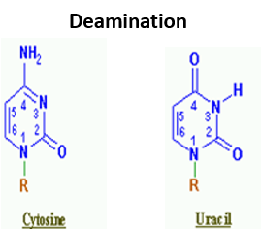

Causes of mutation
1. Spontaneous:
Can be caused by:
Depurination – Loss of a purine base (A or G) to form an apurinic site (AP site).
Deamination – Hydrolysis changes a normal base to an atypical base containing a keto group in place of the original amine group. Examples include C → U

Slide 8
Slipped strand mispairing – is a mutation process which occurs during DNA replication. It involves denaturation and displacement of the DNA strands as a result of deletion, resulting in mispairing of the complementary bases.

Slide 9
Causes of mutation
2. Induced:
Can be caused by mutagens (physical, chemical or biological agents that change the DNA). These include:
a. Physical mutagens
  Ionizing radiations: such as X-rays, gamma rays and alpha particles may cause DNA breakage and other damages.
  Ultraviolet radiations with wavelength above 260 nm are absorbed strongly by bases, producing pyrimidine dimers, which can cause error in replication if left uncorrected.
  Radioactive decay, such as ¹⁴C in DNA which decays into nitrogen

Slide 10
b. DNA reactive chemicals
  Reactive oxygen species (ROS) - These may be superoxide, hydroxyl radicals and hydrogen peroxide, and large number of these highly reactive species are generated by normal cellular processes, for example as a by-products of mitochondrial electron transport, or lipid peroxidation. A number of mutagens may also generate these ROS.

Slide 11
  Deaminating agents such as nitrous acid
  Polycyclic aromatic hydrocarbon (PAH)
  Alkylating agents such as ethylnitrosourea. The compounds transfer methyl or ethyl group to bases or the backbone phosphate groups.
  Aromatic amines

Slide 12
c. Base analogs
  Base analog, which can substitute for DNA bases and cause copying errors.
d. Intercalating agents
  such as ethidium bromide and proflavine are molecules that may insert between bases in DNA, causing frameshift mutation during replication.
e. Metals
Many metals, such as arsenic, cadmium, chromium, nickel and their compounds may be mutagenic,

Slide 13
f. Biological agents
  Transposon, a section of DNA that undergoes autonomous fragment relocation/multiplication. It is a DNA sequence that can change its position within a genome, creating or reversing mutations. Its insertion into chromosomal DNA disrupt functional elements of the genes.
  Virus - Virus DNA may be inserted into the genome and disrupts genetic function.
  Bacteria - some bacteria such as Helicobacter pylori cause inflammation during which oxidative species are produced, causing DNA damage by reducing efficiency of DNA repair systems thereby increasing mutation.

Slide 14
Types of mutation
Point mutations:
Involve alteration in a single base pair, and small deletions generally directly affect the function of only one gene
II. Chromosomal abnormalities:
Involve alterations in large segments of DNA.

Slide 15
Types of mutation
Point mutation
Substitution
Frameshift
Chromosomal aberration
Numerical
Structural

Slide 16

Point Mutation
  I- Substitution
A substitution is a mutation that exchanges one base for another (a change in a single nitrogenous base such as switching an A to a G, also known as single nucleotide polymorphism “SNP”).

Slide 17
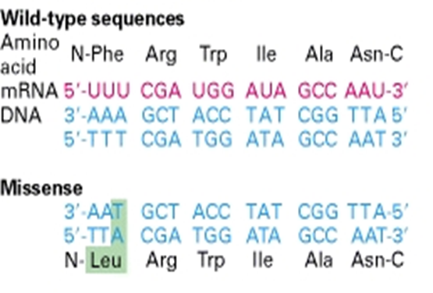

Such a substitution could:
Missense mutation: change a codon to one that encodes a different amino acid and cause changes in the protein produced. Example is sickle cell anaemia.

Slide 18
Neutral mutation: change a codon to one that encodes a chemically similar amino acid and thus has no effect on fitness.
Silent mutations: change a codon to one that encodes the same amino acid and causes no change in the protein produced.
Nonsense mutations: change an amino-acid-coding codon to a single "stop" codon and cause an incomplete protein. This can have serious effects since the incomplete protein probably won't function.

Slide 19
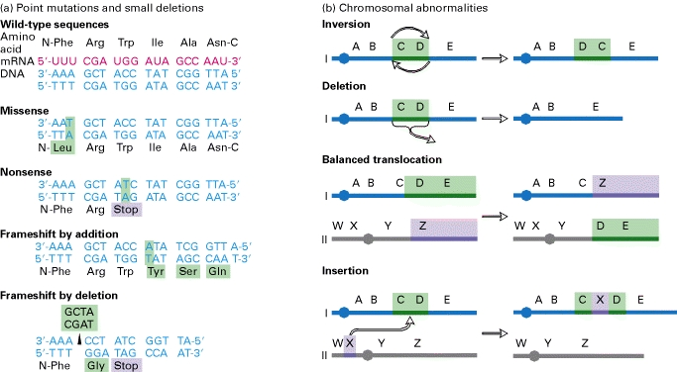

Slide 20
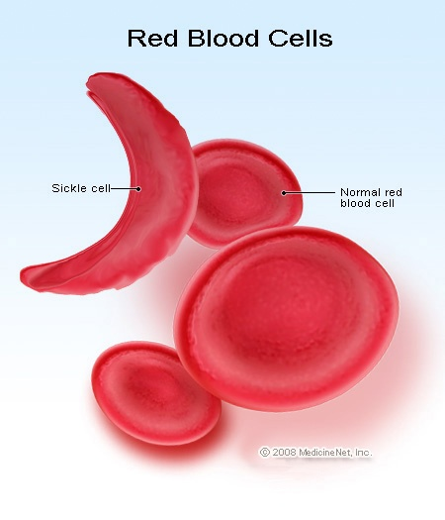


Sickle cell anaemia (SCA)
Sickle cell anaemia is a type of haemolytic anaemia. the disease passed down through families in which red blood cells form an abnormal crescent shape.
Genetic basis:
Adenine to thymine (A-to-T) transversion in the sixth codon of the gene coding for β subunit of Hb causing glutamate to valine substitution.

Slide 21
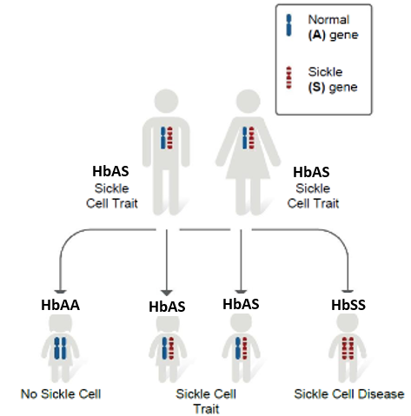
Type of Inheritance:
Autosomal recessive
(Hb SS).

Slide 22
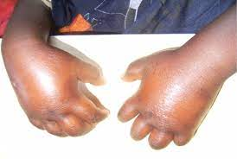
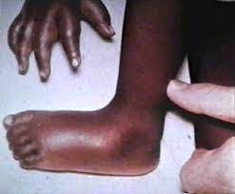
General Symptoms
Symptoms do not usually appear until late in the first year. Most commonly, they include:
Fever
Swelling of the hands and feet
Pain in the chest, abdomen, limbs, and joints
Nosebleeds and frequent upper respiratory infections
Fatigue and shortness of breath (signs of anaemia)
Irritability , Jaundice

Slide 23
Biochemical basis:
Glutamate is hydrophilic (negatively charged) while valine is hydrophobic.
In sickle cell haemoglobin (HbS), Val replaces the 6 Glu of HbA, creating a "sticky patch" that has a complement on deoxy Hb (but not on oxy Hb). This causes deoxy HbS to polymerize at low O2 concentrations, forming fibres that distort erythrocytes into sickle shapes.
These cells undergo haemolysis, and anaemia results. Painful vaso-occlusive crises also occur, and end organ damage may result.

Slide 24
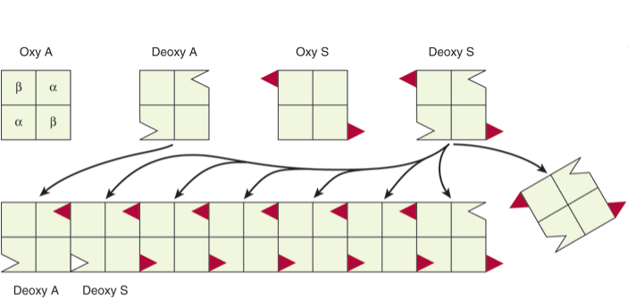
Representation of the sticky patch ( )on Hb S and its "receptor“ ( ) ))on deoxy Hb A and deoxy Hb S. The complementary surfaces allow deox Hb S to polymerize into a fibrous structure, but the presence of deoxy Hb A will terminate the polymerization by failing to provide sticky patches.

Slide 25
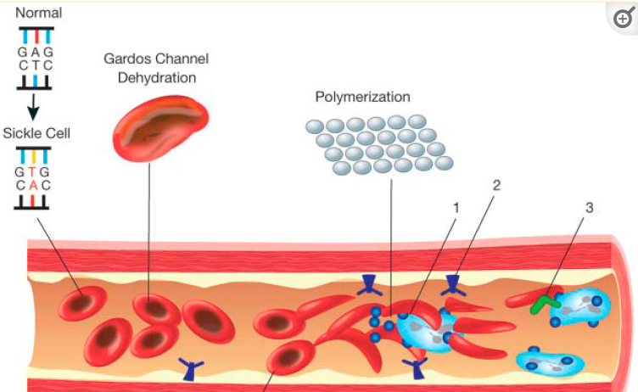

Slide 26
Test & diagnosis
Haemoglobin electrophoresis
Polymerase chain reaction (PCR)
It is more commonly found among African population and Americans of African origin

