Slide 1

Mutation
1- Point mutation
Lecture 2-2 continuation….
Dr. Dina Ahmed H. Ibrahim

Slide 2
Types of mutation
Point mutation
Substitution
Frameshift
Chromosomal aberration
Numerical
Structural

Slide 3
Point Mutation
II- Frameshift:
A frameshift mutation is a genetic mutation caused by insertions or deletions of nucleotides in a DNA sequence that shifts the way the sequence is read.

Slide 4
Frameshift Mutation
A- Insertion Mutation:
Analogy:
The cat ate the rat
add the letter “c”
The ccat ate the rat
Reread as 3 letter words
The cca tat eth era t

Slide 5
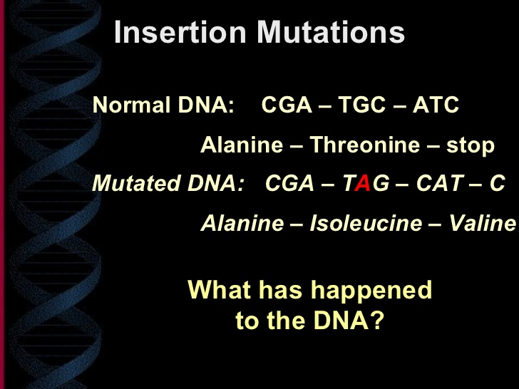

Slide 6
A nitrogen base is inserted/added to the sequence.
It causes the triplet “frames” to shift.
It always affects the amino acids and, consequently, the protein.

Slide 7
Huntington's disease (HD)
HD is a neurodegenerative genetic disorder that affects muscle coordination and leads to cognitive decline and dementia. It typically becomes noticeable in middle age. The symptoms develop between 30 & 50 years.

Slide 8
Genetic basis
Mutation in Huntingtin gene (Htt)
  Htt contains a sequence of three DNA bases—cytosine-adenine-guanine(CAG)—repeated multiple times (i.e....CAGCAGCAG...), known as a trinucleotide repeat.
  CAG is the genetic code for the amino acid glutamine.

Slide 9
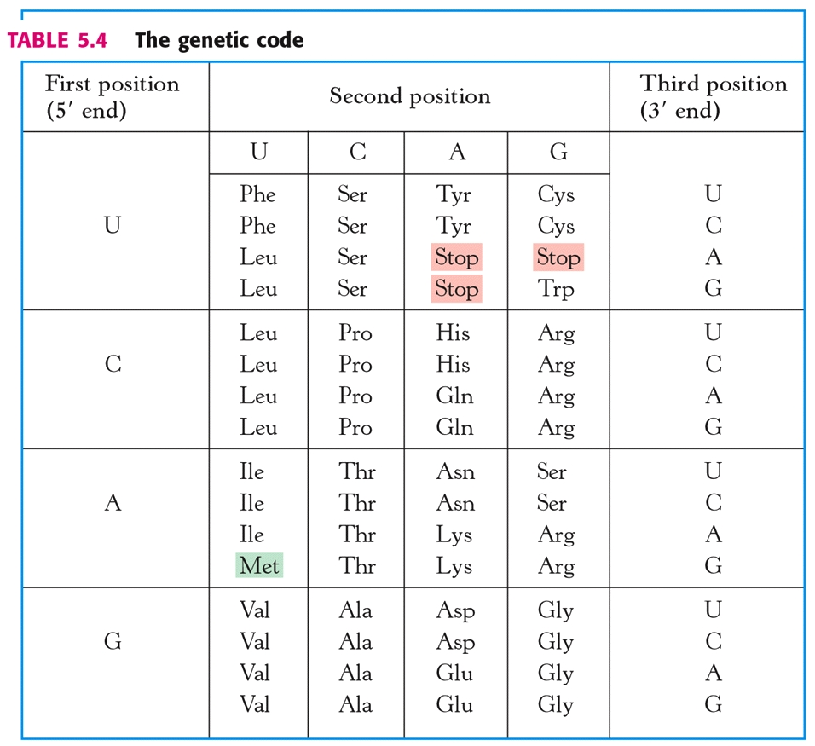

Slide 10
  A sequence of 40 or more glutamines results in the production of mutant Htt gene
  Mutant Htt increases the decay rate of certain types of neurons

Slide 11
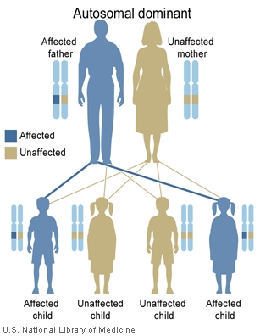
Type of Inheritance:
Autosomal dominant
- Test & diagnosis:
DNA is analysed for the genetic mutation by counting the number of CAG repeats in the specific gene. Individuals who do not have HD usually have 28 or fewer repeats; people with Huntington disease usually have 40 or more repeats.
1
2
3
4

Slide 12
Biochemical basis of the disease
Htt is expressed in all mammalian cells especially in the brain and testes but the function in human is unclear.
The expanded CAG repeats are translated into an abnormally long polyglutamine tract close to the N-terminus of the Htt protein.
The presence of the polyglutamine expansion causes the mHtt protein to misfold and form aggregates in neurons resulting in neurotoxicity characterized by the disease.

Slide 13
Frameshift Mutation
B- Deletion Mutation
Analogy:
The cat ate the rat
remove the “e”
Th cat ate the rat
Reread as 3 letter words
Thc ata tet her at

Slide 14
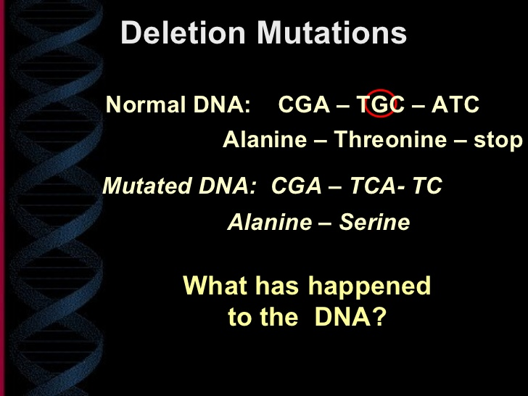

Slide 15
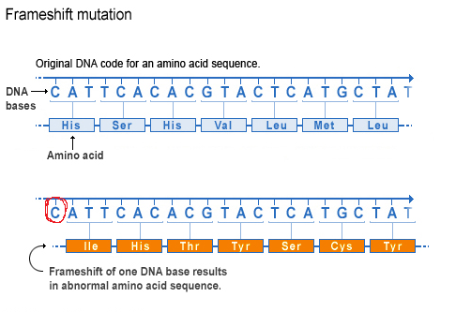

Slide 16
A nitrogen base is deleted from the sequence.
It causes the triplet “frames” to shift.
It always affects the amino acids and, consequently, the protein.

Slide 17
Cystic Fibrosis (CF)
CF is an inherited disorder that causes severe damage to the lungs, digestive system and other organs in the body.
It affects the cells that produce mucus, sweat and digestive juices make them sticky and thick.
Instead of acting as lubricants, the secretions plug up tubes, ducts and passageways, especially in the lungs and pancreas.

Slide 18
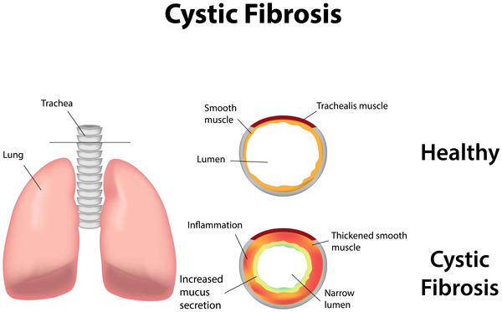

Slide 19
Symptoms:
I- Respiratory symptoms:
The thick and sticky mucus associated with CF clogs the airways in the lungs. Excess mucus in the lungs can lead to the following signs and symptoms such as:
A persistent cough that produces thick mucus (sputum)
Wheezing
Exercise intolerance
Repeated lung infections
Inflamed nasal passages or a stuffy nose
Recurrent sinusitis

Slide 20
Symptoms:
II- Digestive symptoms
The thick mucus can also block tubes that carry digestive enzymes from the pancreas to the small intestine. The result is often:
Foul-smelling, greasy stools
Poor weight gain and growth
Intestinal blockage, particularly in newborns (meconium ileus)
Chronic or severe constipation

Slide 21
Genetic basis
CF is caused by mutations in the CF transmembrane conductance regulator (CFTR) gene which regulates ion conductance across the cell membrane
CF is due to deletion of three nucleotides which code for phenylalanine at position (delta F508) causing the loss of a phenylalanine residue.
This deletion occurs in the tenth exon of the CFTR gene.

Slide 22
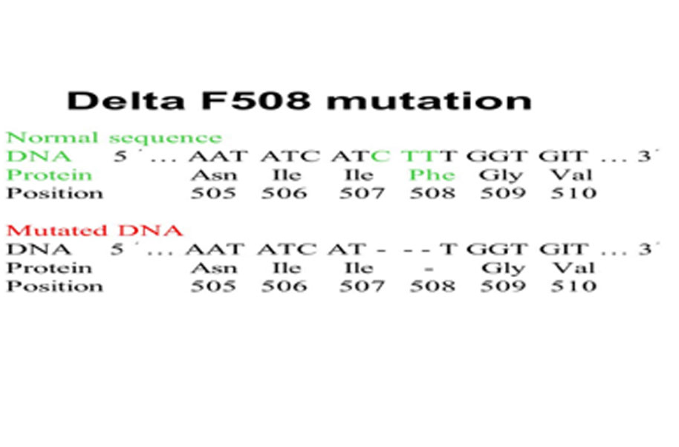

Slide 23
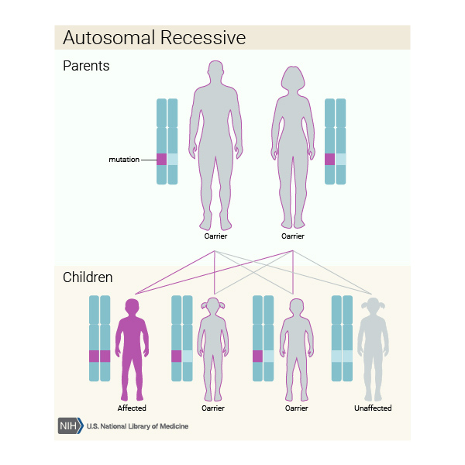
Mode of Inheritance:
Autosomal recessive
- 25% homozygous mutant (CF)
- 50% heterozygous (carrier)
- 25% homozygous normal (unaffected)

Slide 24
Biochemical basis of the disease
The cystic fibrosis gene codes for a cystic fibrosis trans membrane conductance regulating protein (CFTR) which regulates ion conductance across the cell membrane.
CFTR is an anion channel mainly conducting Cl⁻ across the apical membranes of many different epithelial cells.
The delta 508 defect leads to a deletion of phenylalanine from this protein, impairing its function.
Dysfunctional CFTR causes dysregulation of epithelial fluid secretion and thickening of the mucus. This, in turn, leads to the dysfunction of organs such as the lungs, pancreas, kidney and liver.

